Slide 1
Characterization of the Immune Response to SARS COV-2 in COVID-19

Slide 2
BACKGROUND
On Dec 31 2019 the WHO country office in China was alerted to media reports of an outbreak of atypical pneumonia cases in Wuhan
Jan 9 2020 Chinese officials report that the cases are due to a novel coronavirus
Jan 11 WHO receives genetic sequencies of the novel coronavirus from Chinese officials
Jan 13 Thailand Reports the first lab confirmed case of novel coronavirus outside China
Jan 21 The United States confirms the first case, WHO confirms at least some human to human transmission
June 28 WHO declares a pandemic

Slide 3
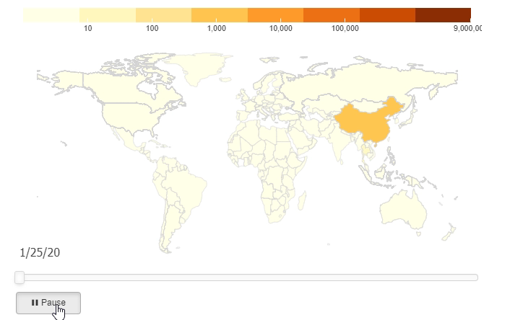
BACKGROUND

Slide 4
WHAT HAPPEND
Basic public health measures failed to keep the spread of this virus located to one region or country due to several complex issues:
Delayed identification of human-to-human transmission
Asymptomatic spread
An increasingly global economy and fast pace of travel across continents.
While some of the most low-tech and effective measures have failed there have been some successes:
Fast sequencing and publication of the genome of SARS-COV-2
Rapid work on the development of a vaccine and therapeutics

Slide 5
Our Study
A protein microarray containing 18 of the 28 predicted proteins from the SARS-COV-2 genome was constructed.
10 proteins were excluded as they could not be purified to an acceptable standard or obtained from commercial sources.
Sera from 28 patients who had convalesced from COVID- 19 were obtained on the day of their discharge.

Slide 6
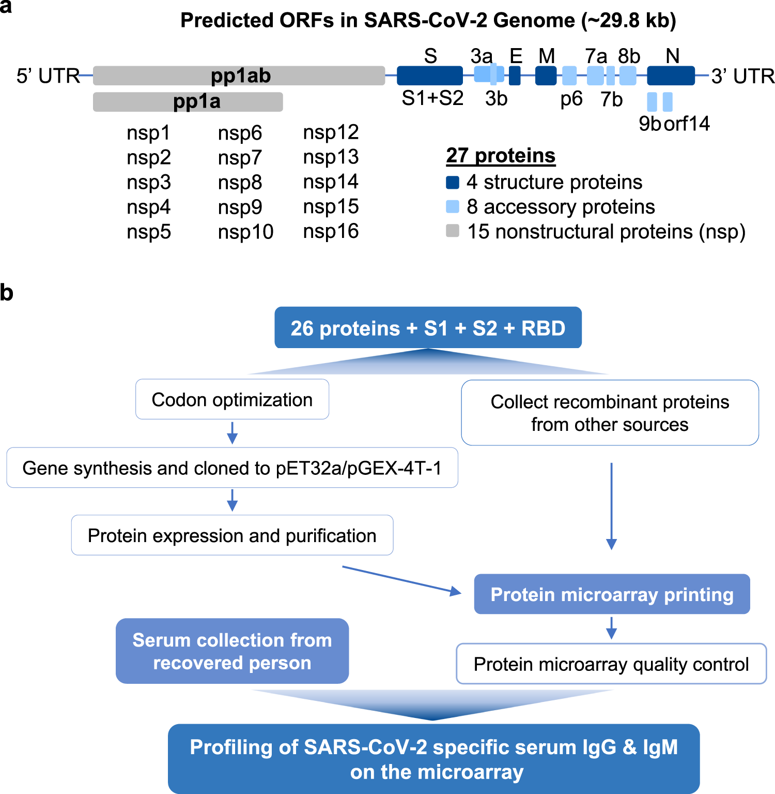

Slide 7
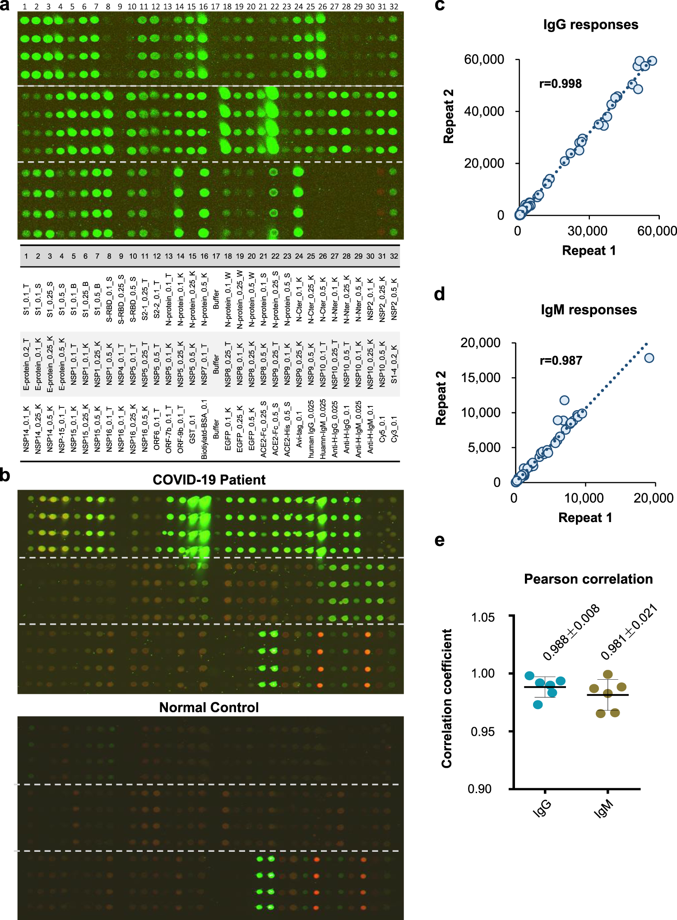

Slide 9
Analysis

Slide 10
Results
IgG responses against S1 protein were positively correlated with peak lactate dehydrogenase levels and inversely correlated with percentage of lymphocyte, finding which tend to correlate with the severity of illness.

Slide 11
Opportunities for Further Work

Slide 12
References

